Slide 1
Statistical Thinking for Machine Learning – Part 3

Slide 2
Welcome Back! What have we learned so far?
Understanding data and different types of data
Distributions, PDF & CDF, Method of Moments
Sampling and Descriptive Statistics
Hypothesis testing to evaluate a single parameter
Bivariate Linear Model
Correlation vs. Causation

Slide 3
Agenda
Multivariate Linear Regression
Form and interpretation
Model evaluation
Omitted variable bias
Multicollinearity – correlated independent variable
Hypothesis Testing
Testing multiple parameters at once – T test vs. F test
Testing equality of two parameters
The Wald Test
Variable Transformations – Interpreting Results
Affine
Polynomial
Logarithmic
Dummy Variables
Interactions

Slide 4
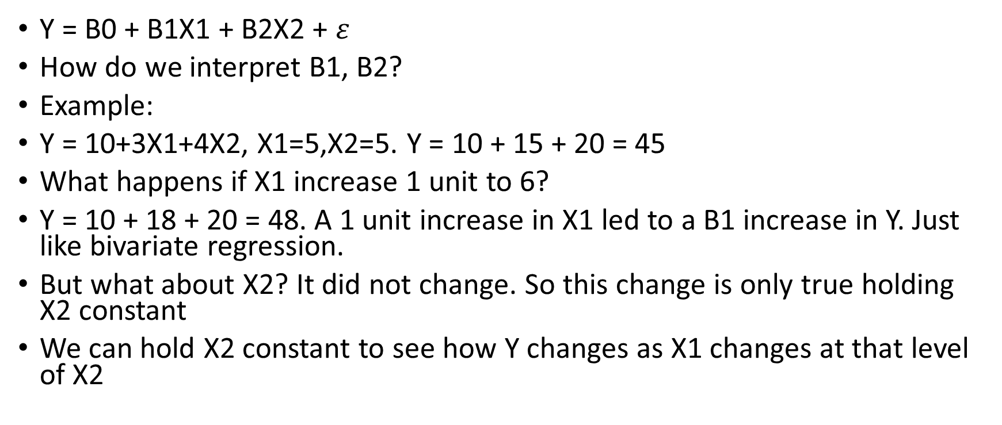
Multivariate Regression
Y = B0 + B1X1 + B2X2 + $ε$
How do we interpret B1, B2?
Example:
Y = 10+3X1+4X2, X1=5,X2=5. Y = 10 + 15 + 20 = 45
What happens if X1 increase 1 unit to 6?
Y = 10 + 18 + 20 = 48. A 1 unit increase in X1 led to a B1 increase in Y. Just like bivariate regression.
But what about X2? It did not change. So this change is only true holding X2 constant
We can hold X2 constant to see how Y changes as X1 changes at that level of X2

Slide 5

Evaluating the Model – Adjusted R Squared
Recall we use R² = 1 – SSR/TSS to evaluate how we our model performed
When we add a new independent variable, TSS does not change. TSS = (Y-mean(Y))²
However, the new variable will always cause of SSR, (y-yhat)², to decrease. Therefore, R squared will always decrease, indicating adding more variables is always better.
Adjusted R squared accounts for the fact that we have added a new variable:

Slide 6
Omitted Variable Bias
If we do not use multiple regression, we may get a biased estimate of the variable we do include
“The bias results in the model attributing the effect of the missing variables to the estimated effects of the included variable”
In other words, there are two variables that determine Y, but our model only knows about one. The model we estimate that the one variable accounts for the full effect of Y, when we know the effect should be split between the two variables
Let’s see an intuitive example:

Slide 7
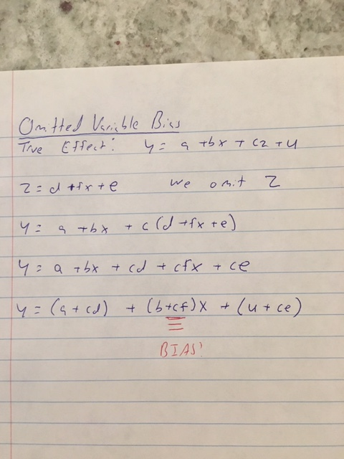

Slide 8
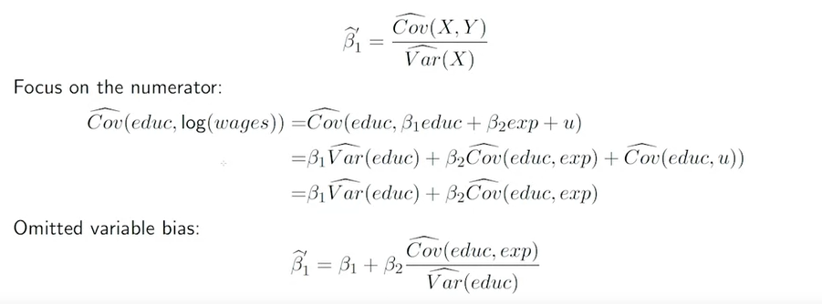
Omitted Variable Bias
When will there not be an omitted variable bias effect?
Intuitively, we can think of two reasons:
The second variable has no effect on Y. Therefore, there is no extra effect to go into the first variable
X1 and X2 are completely unrelated. Therefore, even though X2 has an effect on Y, X1 knows nothing about it.
Let’s see how the math works out:

Slide 9
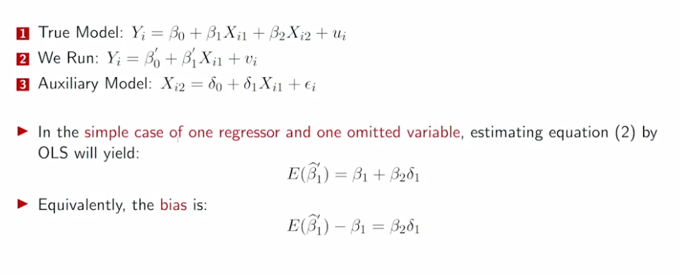
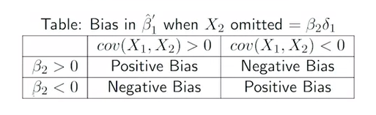
Calculating the Bias Effect
This matches our previous findings that bias = 0 only if B2 or cov(X1,X2) = 0
We can then understand the direction of the Bias

Slide 10
Multicollinearity
Multivariate linear models cannot handle perfect multicollinearity.
Example – We have two variables: X1 and X2 = 3*X1
Fit model to predict Y with X1 and X2:
Y = B0 + B1X1 + NA Model will not give an estimate for X2!
We can think of this as B1 containing the entire effect for both X1 and X2. After all, these variables are the same.
Including highly correlated variables in our model will not produce biased estimates but it will harm the precision.

Slide 11
The Baseball Example
Let’s use home runs, batting average, and RBI to predict salary
Variables are defined as follows:
Salary = homeruns*10000 + eps
BA = homeruns + 270 + eps
RBI = homeruns*3 + eps
Example: Home runs = 30, BA = 300, RBI = 90, Salary = 300,000
Let’s fit a model for each variable individually:
Salary = 9934.27*HR
Salary = 1002.95*BA
Salary = 3291.02*RBI
Let’s fit a model with all three:
Salary = 9226.169*HR+225.884*RBI+2.982*BA
What is this model saying? Why not:
Salary = 9934.27*HR+3291.02*RBI+1002.95*BA

Slide 12
A helpful resource…
Omitted variable bias and multicollinearity discussion:
https://are.berkeley.edu/courses/EEP118/current/handouts/OVB%20versus%20Multicollinearity_eep118_sp15.pdf
Situation | Action
z is correlated with both x and y | Probably best to include z but be wary of multicollinearity
z is correlated with x but not y | Don’t include z, no benefit
z is correlated with y but not x | Include z! New explanatory power
z is correlated with neither x nor y | Should not be much effect when including but could affect hypothesis testing – no real benefit

Slide 13
Hypothesis Testing
The previous example demonstrates why we must use an F test to test all hypothesis simultaneously rather than a T test.
Recall the T-test for H0 → B1 = ϴ: (B1 - ϴ)/se(B1)
The above statistic is t-distributed under the null hypothesis, so we can see how likely it would be to get the above value from a t-distribution.
If we are testing multiple hypotheses, we can apply the same logic as long as we know how that statistic is distributed. In this new test, our statistic will belong to an F-distribution

Slide 14

Back to Baseball…
To perform an F test, we compare a model with restrictions to one without and see if there is a significant difference.
Salary = Years + GmsYear + HR + RBI + BA
If HR, RBI and BA all have no effect on salary, then the model Salary = Years + GmsYear should perform just as well.
How do we measure “performance?” Sum of squared residuals!
Test statistic:
The above fraction is the ratio of two chi squared variables divided by their degrees of freedom, which makes this F-distributed
Remember adding variables can only improve the model, so the F stat will always be positive

Slide 15
Testing equality of two parameters
How should we test B1 = B2?
H0 → B1 = B2 is equivalent to B1 – B2 = 0
Before, when HO → B1 =0, T = B1/sqrt(var(B1))
Now, we can use (B1-B2)/sqrt(var(B1-B2))
What is var(B1-B2)? Answer: Var(B1)+Var(B2)-2*cov(B1,B2)
We must consider the covariance! This is why testing the equality of regression coefficients from different regressions is extremely difficult.

Slide 16
The Wald Test – Multiple Hypothesis Testing Made Easy
The Wald Test enables multiple hypothesis of different types to be tested simultaneously with one convenient formula.
Like the F-test, the Wald test tells you only whether or not ALL of the null hypothesis are true.
The Wald statistic is Chi squared distributed and is calculated using the below formula:
t(R*B-r)*inv(R*V*t(R))*(R*B-r)
B = Vector of coefficients
R = Matrix where rows represent the left side of the null hypothesis and columns represent the coefficients
r = Vector containing the corresponding right hand side of each null hypothesis
V = Variance/Covariance matrix for regression coefficients
Degrees of freedom = # of hypothesis

Slide 17
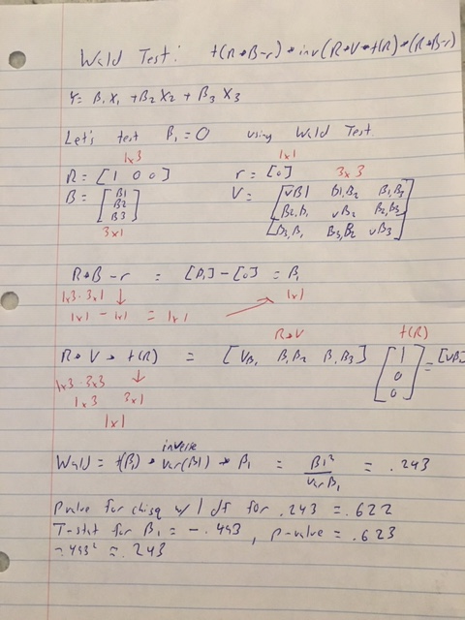
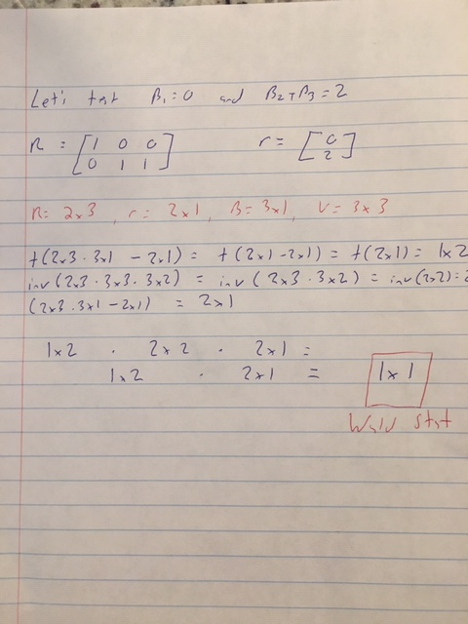

Slide 18
Types of Variables and Transformations
Transforming variables and/or including different types of variables can improve model performance
Let’s look at different options:

Slide 19
Affine
Affine transformations are transformations that don’t effect the fit of the model. The most common example is scaling transformations.
Example:
Weight (lbs) = 5 + 2.4*Height(inches)
Weight (lbs) = 5 + 0.094*Height(mm)
This is why scaling variables is not necessary for linear regression but knowing the scale of your variables is VERY necessary.

Slide 20

Polynomial
Linear regression can still be used to fit data with a non-linear distribution
The model is linear in parameters, not necessarily variables
I.e. we must have B1, B2, B3, but we can utilize X1² or X2/X3
We might leverage the above to generate a curved regression line, providing a better fit in some cases
How do we now interpret the coefficients
The big difference is the effect of an increase in experience on wage now depends on the level of experience

Slide 21
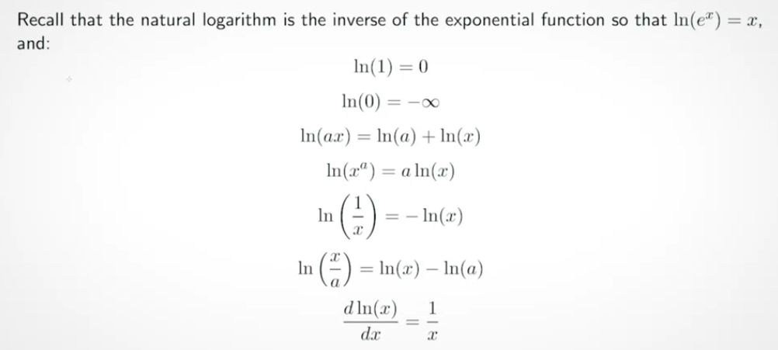
Logarithmic

Slide 22
Interpreting Log Variables
B0 = 5, B1 = 0.2
Level-Log: Y = 5+0.2ln(X)
1 % change in X = B1/100 change in Y
Log-Level: ln(Y) = 5+0.2X
1 unit change in X = B1*100 % change in Y
Log-Log: ln(Y) = 5+0.2ln(X)
1% change in X = B1% change in Y

Slide 23
Dummy Variables
Categorical or “dummy” variables help us represent groups or place continuous variables into bins
What is this regression telling us:
NBA_salary = 5*PPG + 10.5*Guard + 9.6*Forward + 10.8*Center
Do we need dummy variables for Guard, Forward, and Center?
How would the regression change if we only used 2 out of 3?
NBA_salary = 10.5 + 5*PPG – 0.9*Forward + 0.3*Center
Dummy variables or “One-hot encoding” is how categorical variables can be mathematically represented

Slide 24
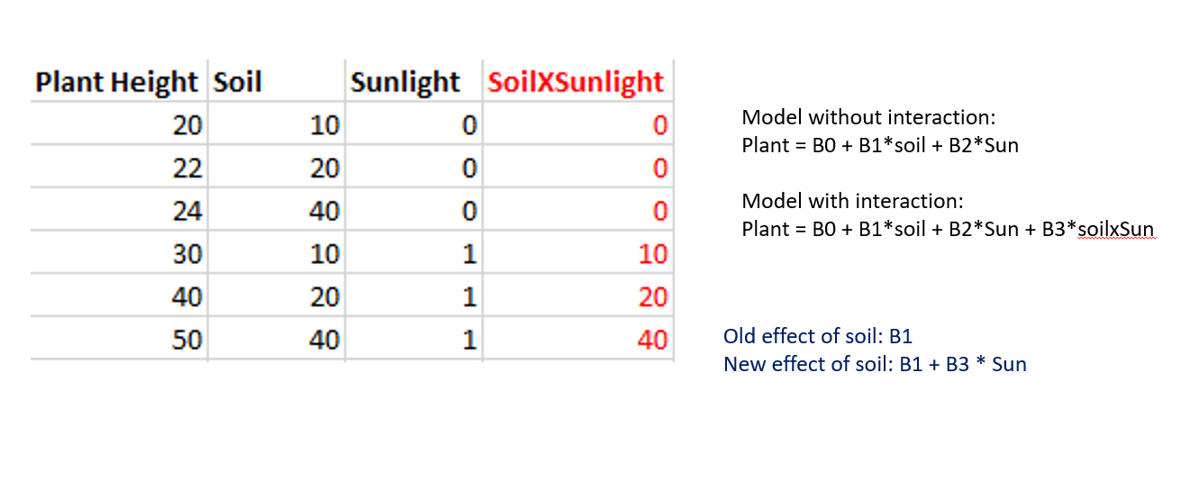
Interaction Terms
What if we want to estimate the effect of a variable, but that variable has a different effect depending on another variable? Answer: Interaction Terms

Slide 25
Up Next…
Using logarithm laws to generate classification models when we have a categorical dependent variable.

